Slide 1
Contact Centre Operations and Performance
Can a machine learning model effectively predict contact centre volume based on DIFOT (delivered in full and on time) Scores
Notes:
Julie - Welcome everyone.
For our project, we undertook to assess if a machine learning model could effectively predict contact centre interaction volume based on the business’ supply chain operational performance metric referred to as DIFOT.
DIFOT is a measure of the percentage of customer orders that were delivered in full and on time.
We have also developed some visuals in Tableau around the data to gain some further insights around the call centre operation.

Slide 2
The aim
Assess if a machine learning model would be effective in predicting contact centre volume based on DIFOT (delivered in full and on time) Scores
Create visualisations showing the correlation between call centre volume and DIFOT and,
Assess other metrics including, volume by media type, volume by media type at each half hour interval, volume by reason
Notes:
Julie - To this end, our key project outcomes then, are.
To assess machine learning feasibility, explore correlations among call center metrics, and evaluate key factors such as volume by media type, reason, and intervals.
If contact centre volume can be predicted to a reasonable degree of accuracy, the business could be more effective in the allocation of resources in the contact centre to ensure adherence to required SLAs and KPIs.
Understanding the reasons customers contact the business can also assist with understanding where self-service capability can be increased or improved to further reduce interaction volume.

Slide 3




Challenges deep-dive
Challenge 1
Challenge 2
Challenge 3
Challenge 4
Source the data
Normalise
Model & Learn
Visualise
Notes:
Dusko - We identified the high level actions being;
Sourcing the data
Normalising in preparation for use in a machine learning model
Modelling and learning through machine learning and,
Developing visualisations around other metrics derived from the data
Over to Julie now to talk about our first challenge…… Julie….

Slide 4
Challenge 1
Genesys PureCloud Contact Centre Platform as the primary data source.
Comprehensive dataset of
daily interactions,
DIFOT scores, and
operational metrics.
We integrate data from two streams:
Genesys API Explorer
SQL Management Server
Source the data
Notes:
Julie - Our exploration is centred on a live Australian Contact Centre who uses Genesys PureCloud as its primary operational platform.
We combined data from two key streams:
a detailed dataset extracted through the Genesys API explorer (via Databricks), requiring Genesys Cloud Licensing, and
data exported from SQL Management Server
As this is a live commercial business, an initial notebook was created within the business' Databricks environment which conducts a daily ingest of contact centre data via APIs and normalises into tables housed within the business' Databricks profile.
For this project, we extracted 12 months worth of data resulting in over 500,000 rows of raw data.

Slide 5
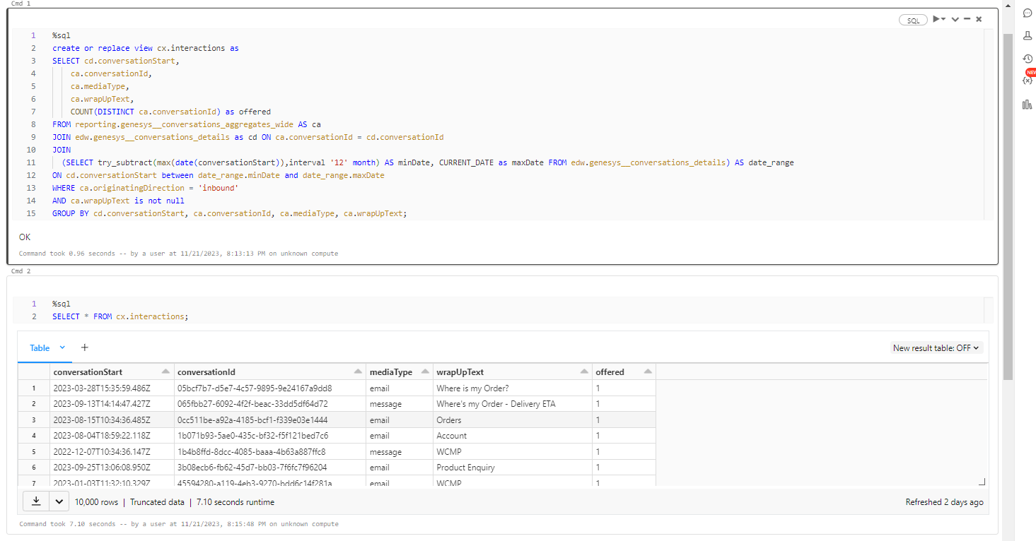
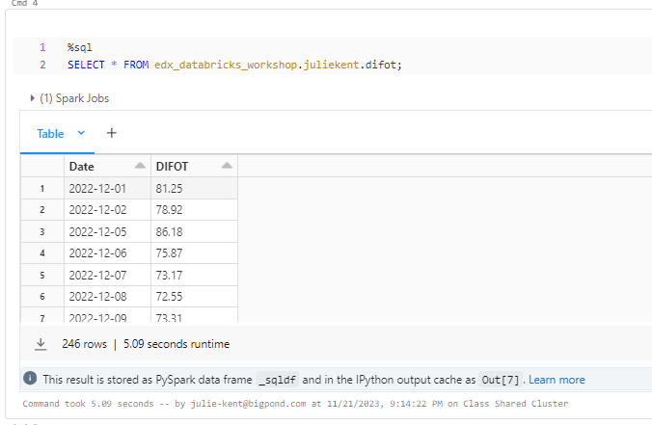
Notes:
Julie - Here is a quick view of the resulting data frames created.
The first, and larger of the 2 images is the resulting dataframe from the notebook created from within the business.
The second and smaller image is the dataframe after it was ingested.

Slide 6
Challenge 2
Ingest
Normalise
Export
Normalise
Notes:
Julie - Once the two dataframes were exported from the business environment, they were ingested into the Databricks environment created for our course group and normalised in preparation to be used in the machine learning model.
Through the normalisation process, Two distinct datasets were created;
"daily_interactions_difot" and "int_by_MediaType" which were then exported as csv files to use in Google Colab.

Slide 7
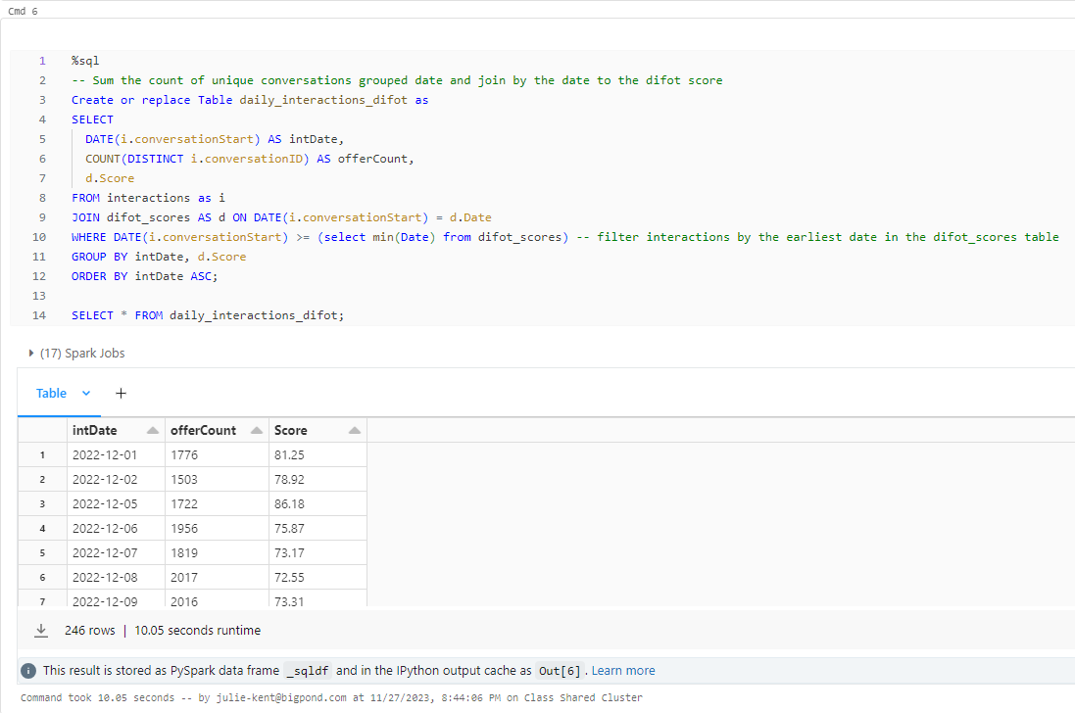
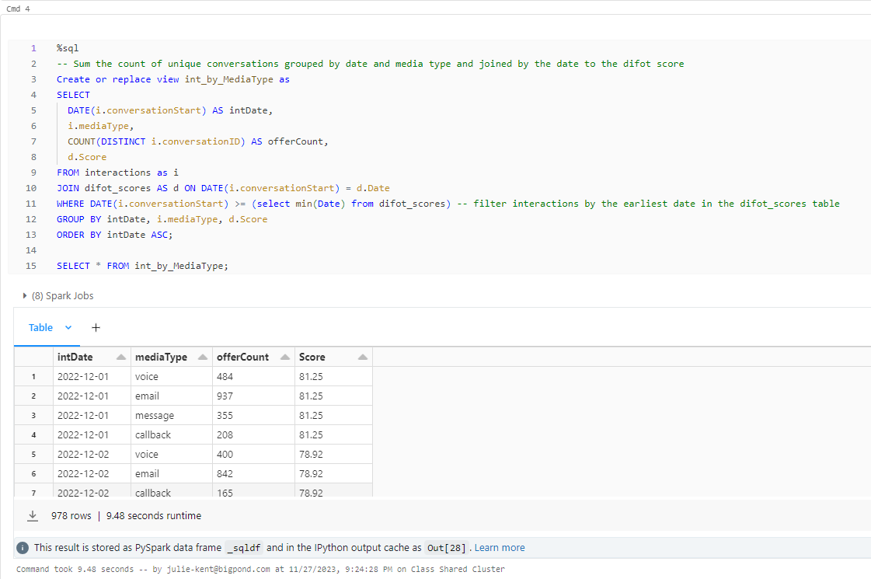
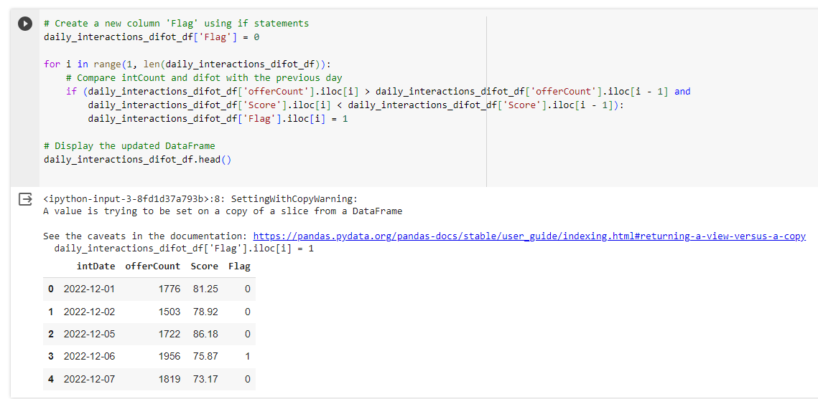
Notes:
Julie - After importing the CSV files into Google Colab, we initiated the final step in the data preparation process by introducing a new column named "flag", using a conditional statement.
This statement returns 1 if the ‘Count’ of interactions for each date is greater than the day prior and difot is lower than the day prior. Otherwise, return 0.
Now, Dusko is going to talk through the machine learning model and results…..Dusko.

Slide 8
Challenge 3
Kerastuner
Hyperparameter
Random Forest
Model and Learn
Notes:
Dusko - Using Google Colab, we refined datasets and leveraged the Keras-Tuner library for hyper-parameter tuning.
This process ensures optimal performance for our machine learning models, establishing a robust foundation for predictive analytics.
The top hyper-parameter configurations were then applied to construct, train, and evaluate the machine learning models.
This approach allowed us to optimise our models for both datasets, ultimately enhancing predictive accuracy and ensuring a robust model performance.

Slide 9
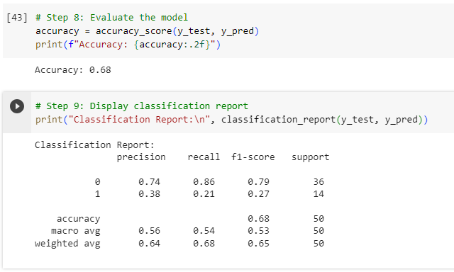
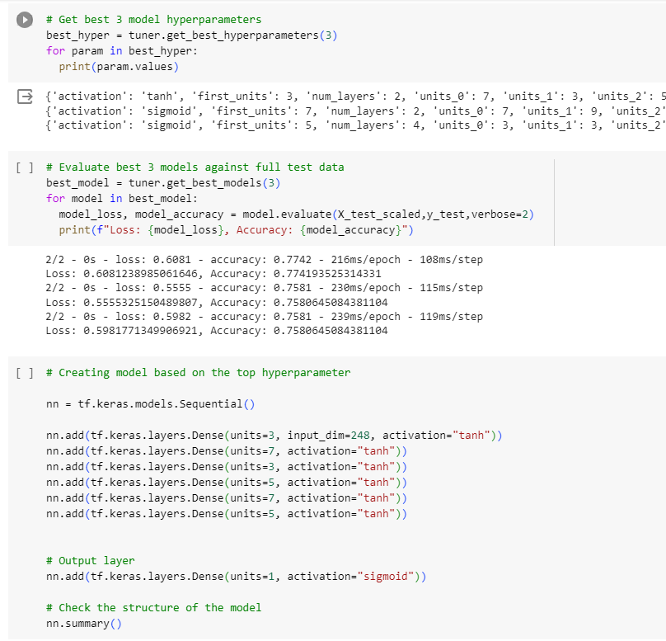
Notes:
Dusko - Initially we employed a random forest model to predict the data accuracy which yielded an overall accuracy of 0.68, accompanied by a weighted F1-score of 0.65.
We were not happy with the level of accuracy achieve thus we moved to a deep learning model for the two datasets.
The "Daily Interactions with DIFOT Score" model has been evaluated using key metrics, where it achieved an accuracy of 75.81%.
The model for predicting "Daily Interactions with Media Type" has demonstrated significantly higher performance, with an accuracy of 94.69%.

Slide 10
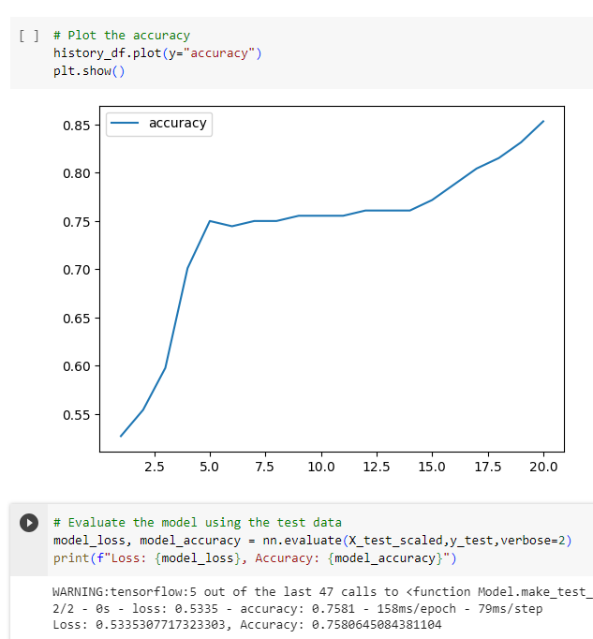
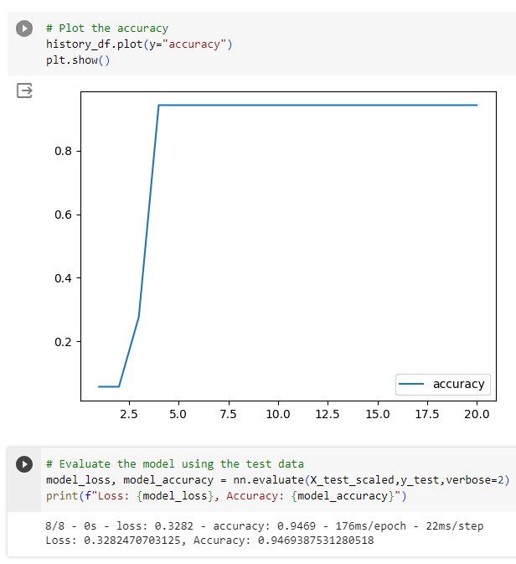
Notes:
Dusko - Here is a quick view of the accuracy plots from the deep learning model.
I will now hand over to Julie to talk about our 4th challenge…. Julie…….

Slide 11
Challenge 4
Interactions v DIFOT
Weekly Volume by Media with DIFOT
Top Call Reasons by Media
Volume by Reason per Month
Volume per Interval
Visualise
Notes:
Julie - Finally, we started to create some visualisations based on the same data used in the machine learning model to look at other insights and opportunities.
These included…
Interactions v DIFOT
Weekly Volume by Media with DIFOT
Top Call Reasons by Media
Volume by Reason per Month
Volume per Interval

Slide 12
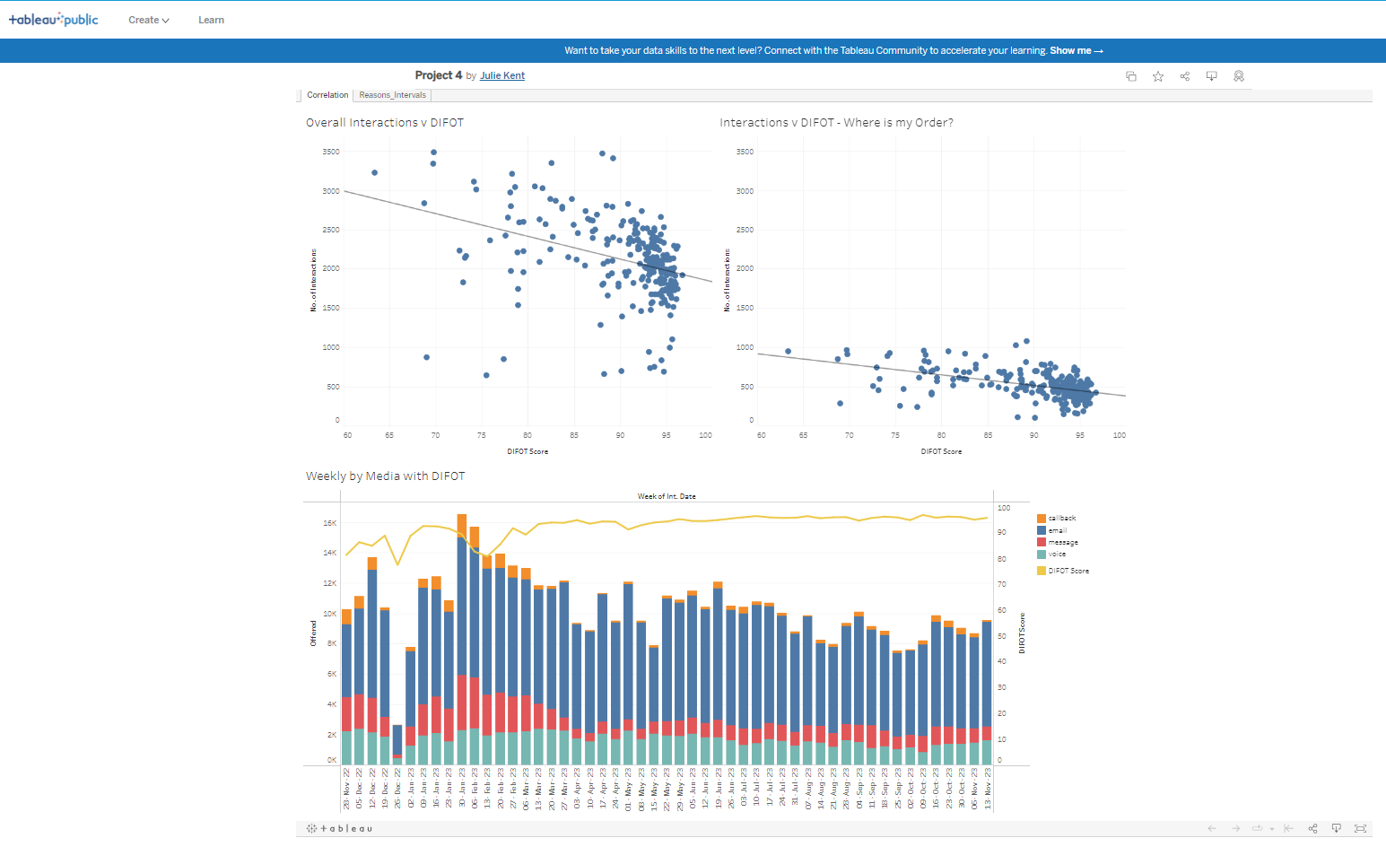
Notes:
Julie - The first visualisation created was the 'Interactions v DIFOT' scatter plot to determine the strength of the relationship between these two metrics.
Overall, we found there is a very weak, negative correlation between contact centre volume and DIFOT as represented in the visual. The overall R-Squared value was barely over 0.1
Even when the data is filtered to represent volume related specifically to order delivery, it still does not strongly support the correlation relationship. The R-Squared value with the additional filter applied only rose to about 0.2.
However, when you look at the DIFOT scores across the 12 months represented in the data, overlayed on the contact centre volumes per week, there is visual corresponding movement evident.

Slide 13
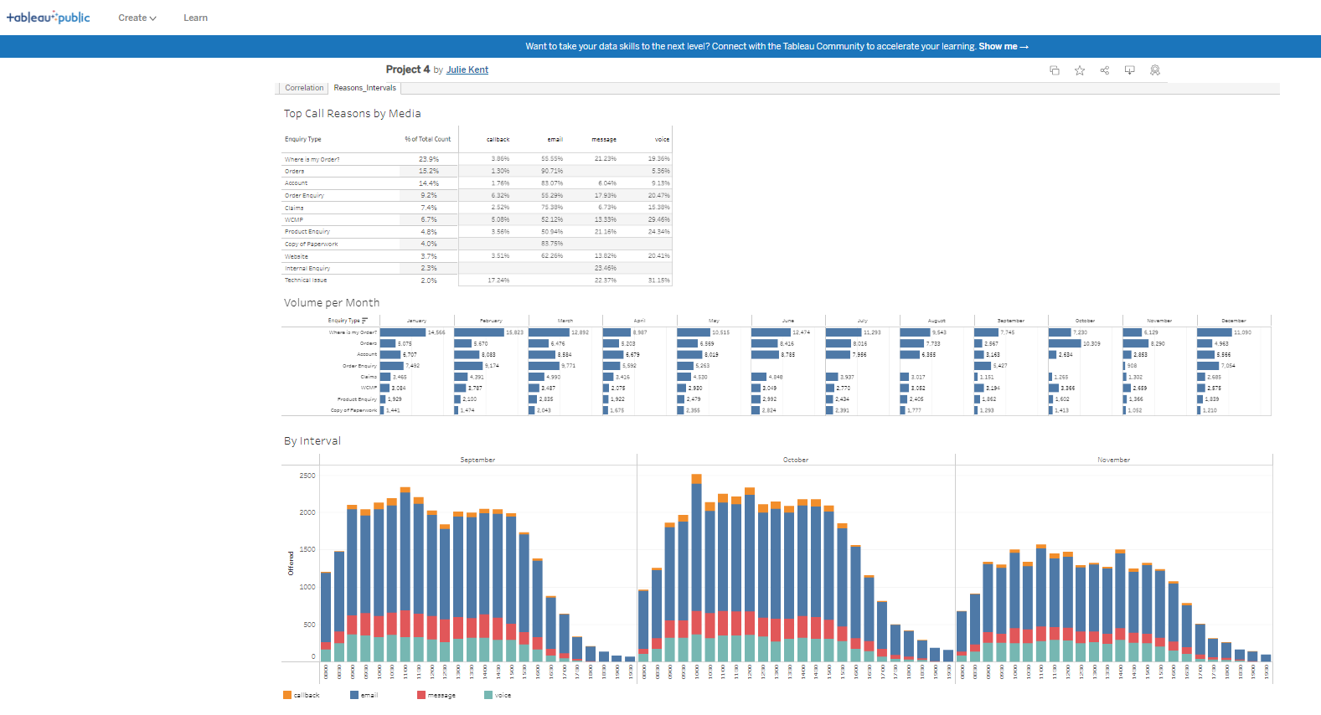
Notes:
Julie - The second set of visualisations created centred around the reasons for the interactions.
While the top 3 reasons a customer contacts the contact centre are, 'Where's my Order?', 'Orders' (order creation) and, 'Account' (account related enquiries), the most popular reason for a customer to reach out through the contact centre is when they are looking for their order, representing 23.9% of the overall contact centre volume.
Finally, a view of the interactions per half hour interval over the last 3 months shows the prevalence of interactions occurring over normal business hours for the East Coast.
While the contact centre is open from 8am to 8pm, Monday to Friday, it does take about an hour each morning for the volume to reach its average peak.

Slide 14
Conclusion
And Future Work
https://github.com/JulieKent/BootCamp_Final-Project4-ML
Notes:
Dusko - Conclusion
In conclusion, the combination of machine learning models and visualisations provides a holistic view of contact centre performance.
Strategic actions based on these insights can lead to improved resource management, better adherence to SLAs, and enhanced self-service capabilities, ultimately contributing to a more efficient and customer-centric contact centre operation.
Future Work
Our current exploration lays the foundation for ongoing enhancements.
Future work involves predicting future call volumes, time series forecasting, call arrival rate and average handle time prediction as well as agent absence rate prediction, agent utilisation modeling, and staffing requirement calculation.
These areas ensure predictive capabilities evolve with the dynamic landscape of customer interactions.
More information about how our project was conducted can be found on our github repository.
Thank you all for your attention and feel free to ask any questions regarding our project.

